Slide 1

SOCIAL MEDIA PROJECT
Presented By:
Jasmin Rajesh Patel

Slide 2
Agenda
Problem statement
Approach
Tech stack use
Insights
conclusion

Slide 3
Problem statement
You are hired as a data analyst at Meta and asked to collaborate with the Marketing team. Marketing teams want to leverage Instagram's user data to develop targeted marketing strategies that will increase user engagement, retention, and acquisition. Provide insights and recommendations to address the following objectives.

Slide 4
About Project
This project is focused on the analysis of users who are using instagram platform.User analysis is the process by which we track how users engage and interact with our digital product (software or mobile application) in an attempt to derive business insights for marketing, product & development teams. This project will answer the problem statements which will help the product team.

Slide 5
About dataset
Users — id, username, created_at
Photos — id, img_url, user_id, created_at
Comments — id, comment_text, user_id, photo_id, created_at
Likes — user_id, photo_id, created_at
Followers — follower_id, followee_id, created_at
Hashtags — id, tag_name, created_at
Photo_tags — photo_id, tag_id

Slide 6
The Executive team want to gain insights of the business operations; thus, we’ll be looking at the following questions to query using MySQL
In today’s data-driven world, effective management and analysis of vast amounts of information are paramount for businesses to thrive. SQL — structured query language stands as a cornerstone in this endeavor, providing a powerful and standardized means to interact with relational databases. In this case study, we delve into the application of SQL within the context of a dynamic social media platform. Here we’ll uncover how SQL enables efficient handling of user's data and makes informed data-driven analysis. Join us as we explore the real-world implications of leveraging SQL to unlock the full potential of data within a modern business landscape.

Slide 7
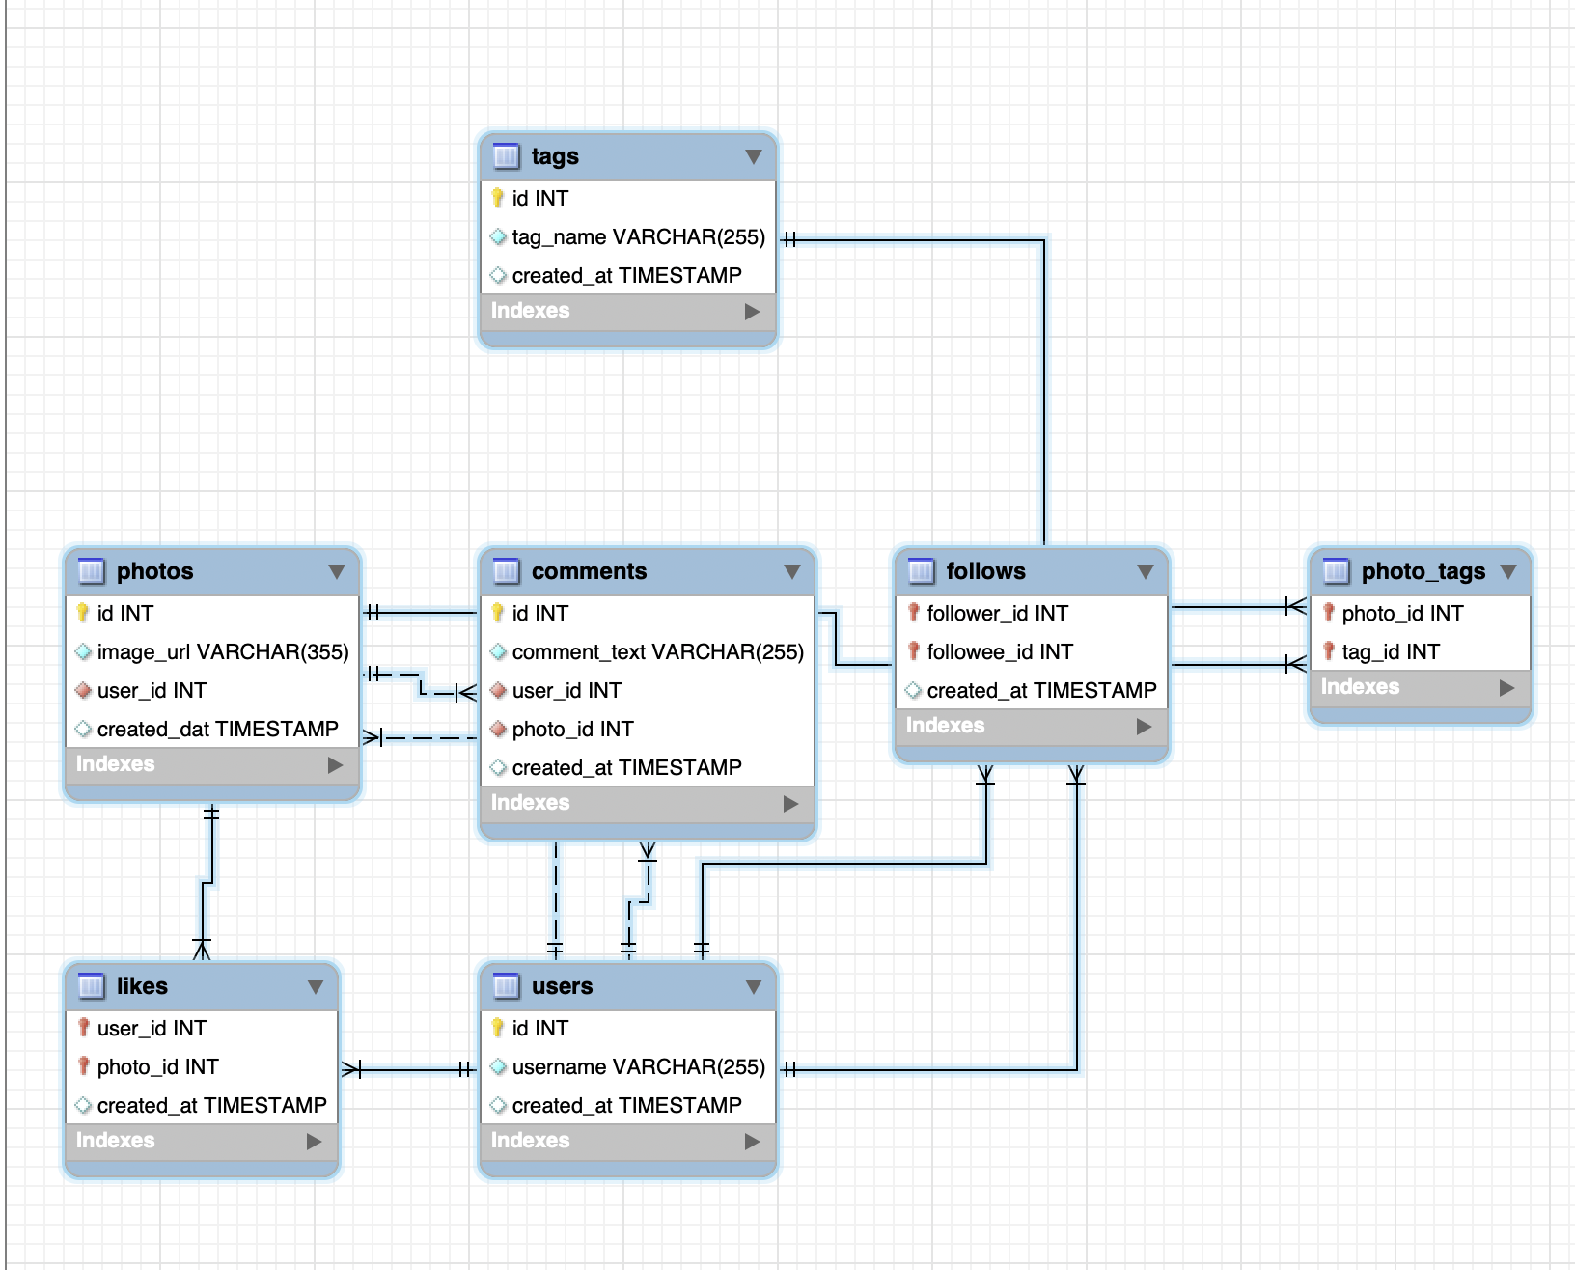
DATABASE SCHEMA

Slide 8
Database creation : Created and inserted the values in the database using the DDL & DML SQL queries provided by Newton School in the MySQL database using MySQL workbench.
Extraction of insights : After creating the database required insights are generated from the database tables by running SQL queries in MySQL workbench.
Tech Stack Use : Used MySQL Community Server - GPL Version 8.0.29 and Connector Version C++ 8.0.29 for creating my project as MySQL Community Server - GPL is a free and open-source relational database management system that uses SQL.

Slide 9
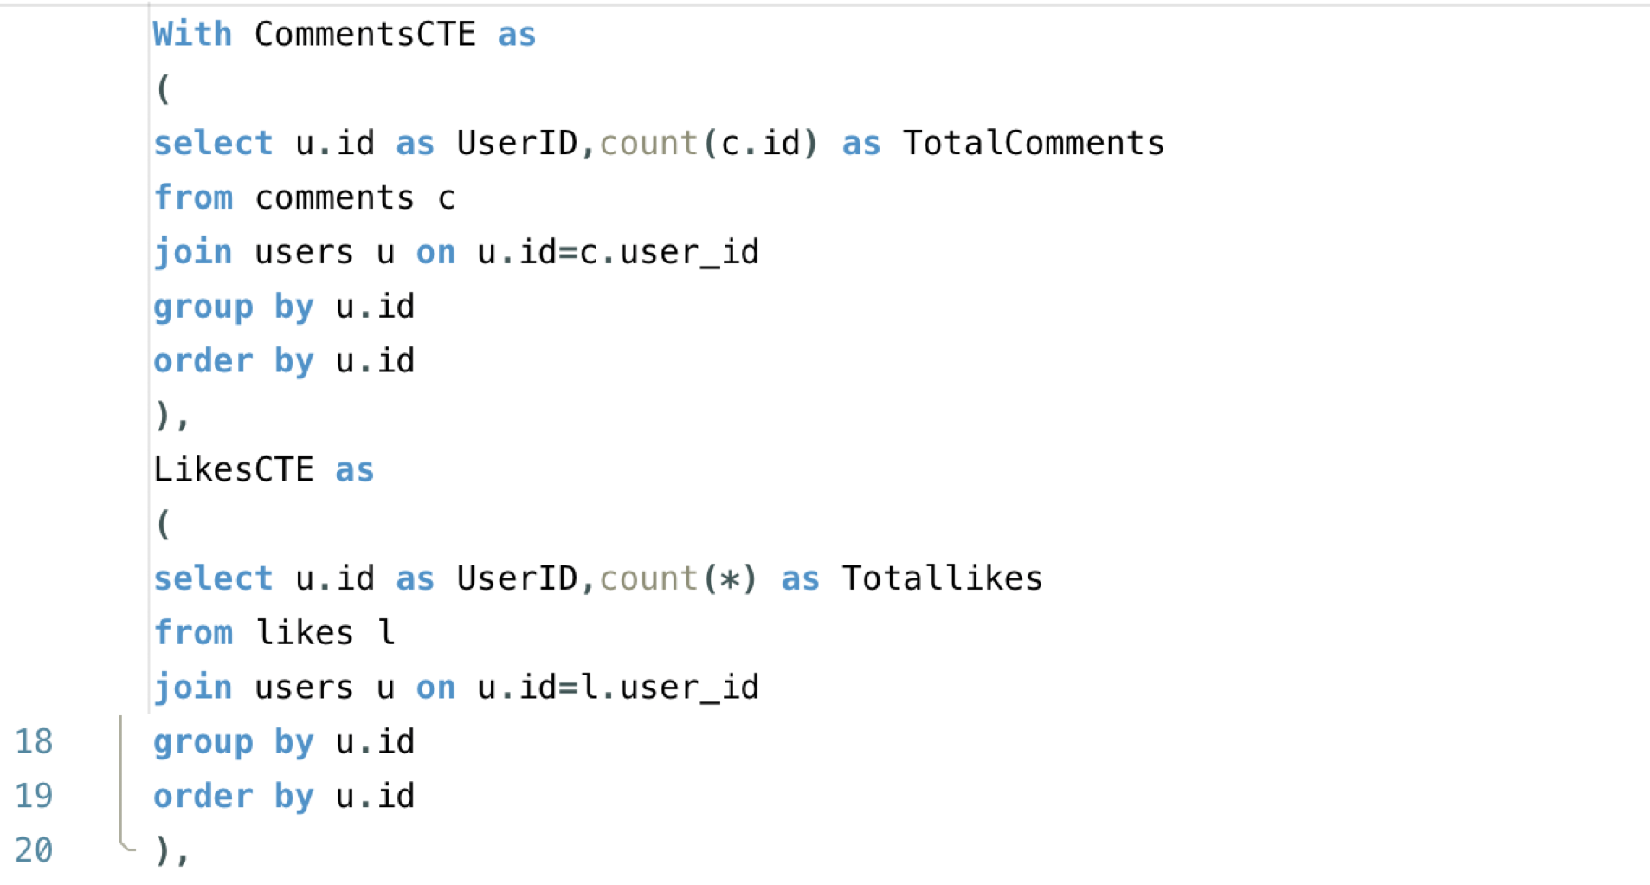
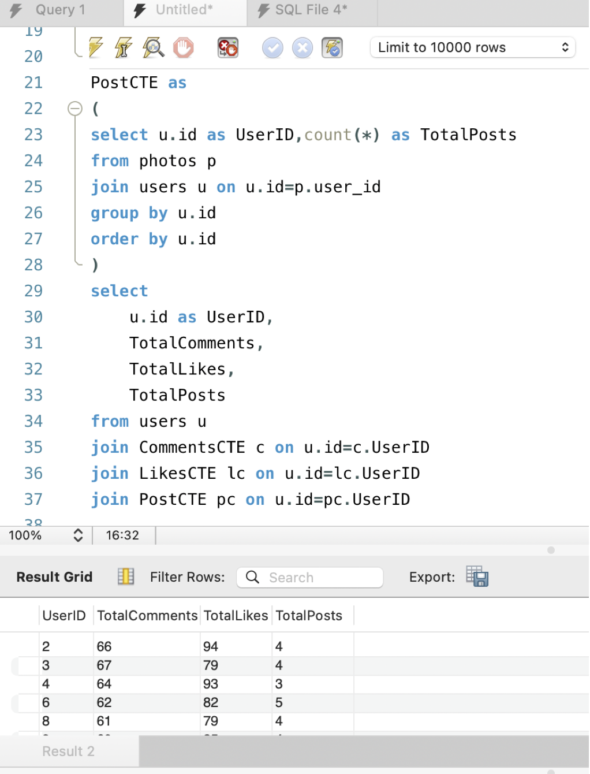
Insights
The distribution of user activity levels (e.g., number of posts, likes, comments) across the user base

Slide 10
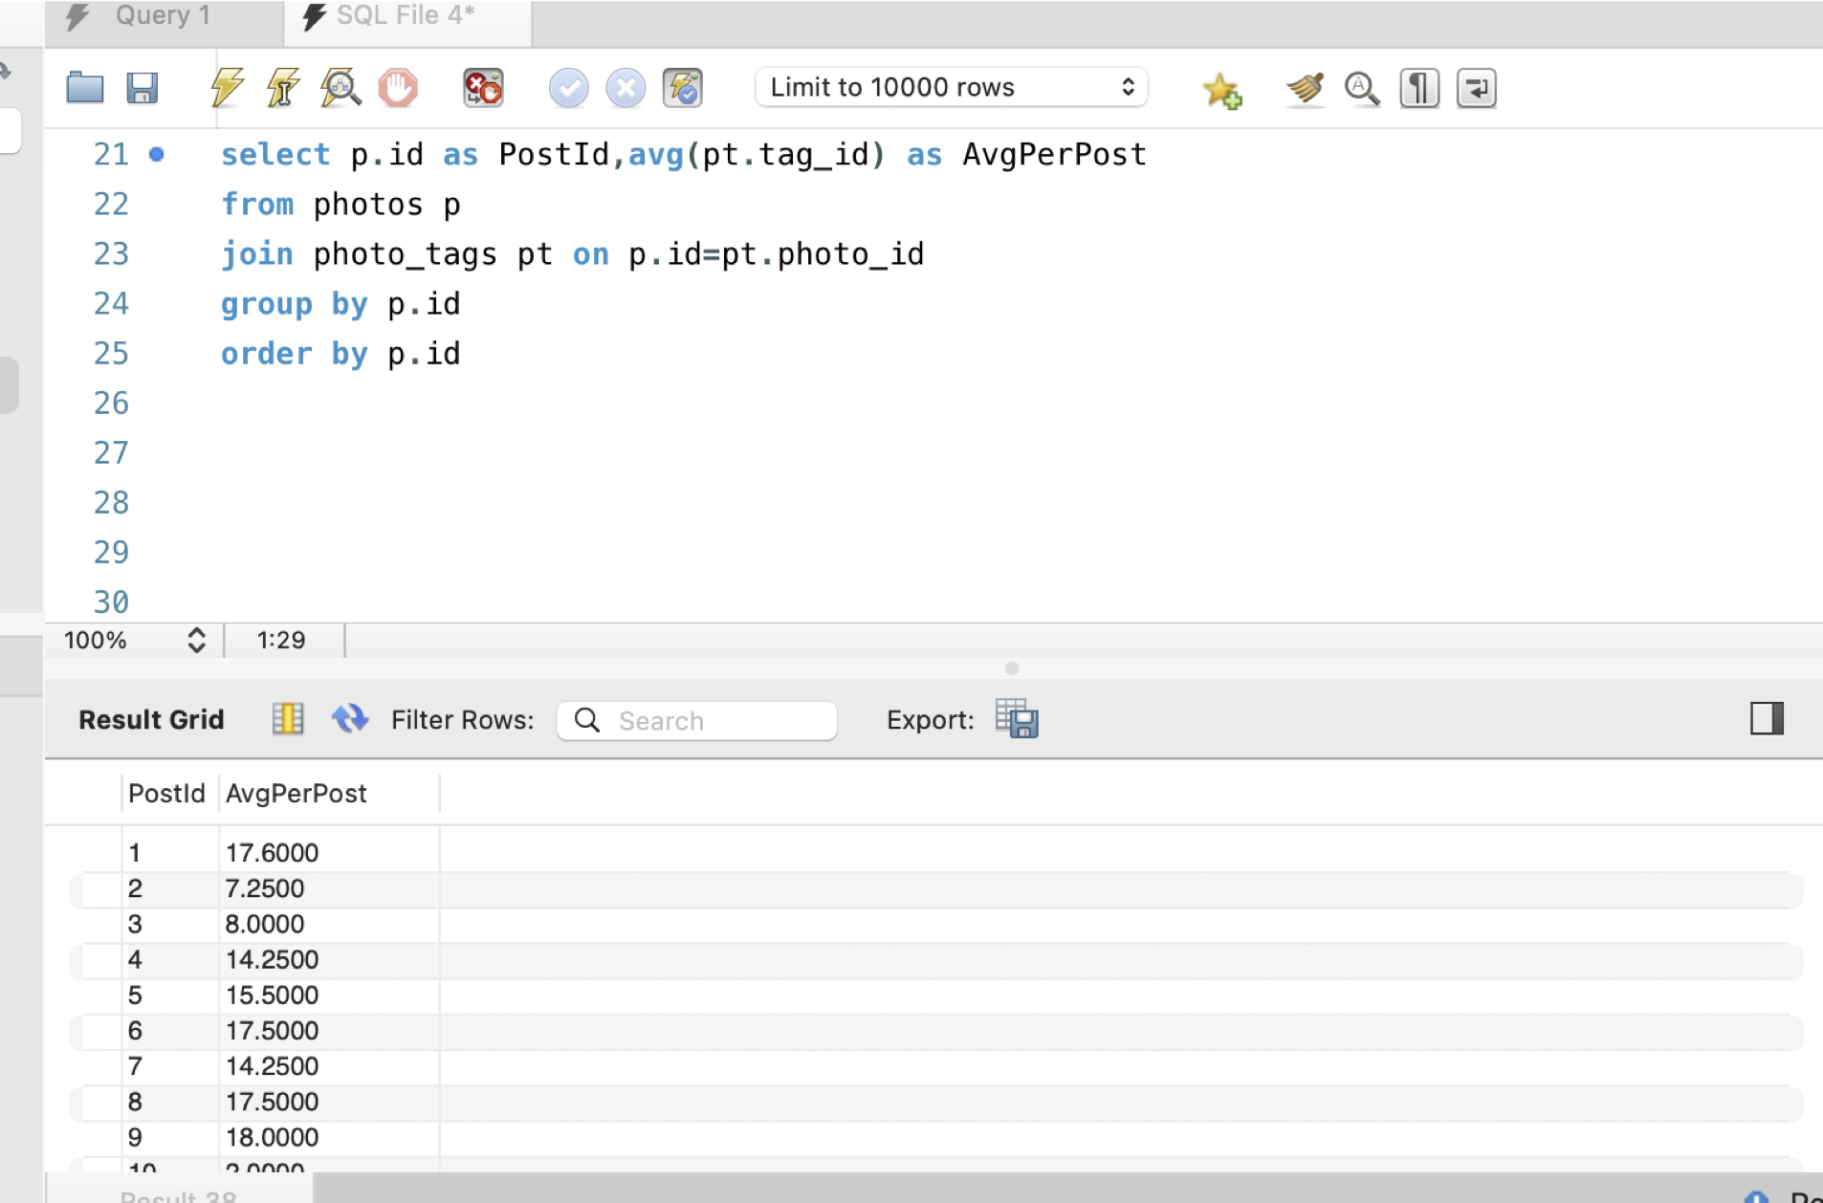
The average number of tags per post

Slide 11
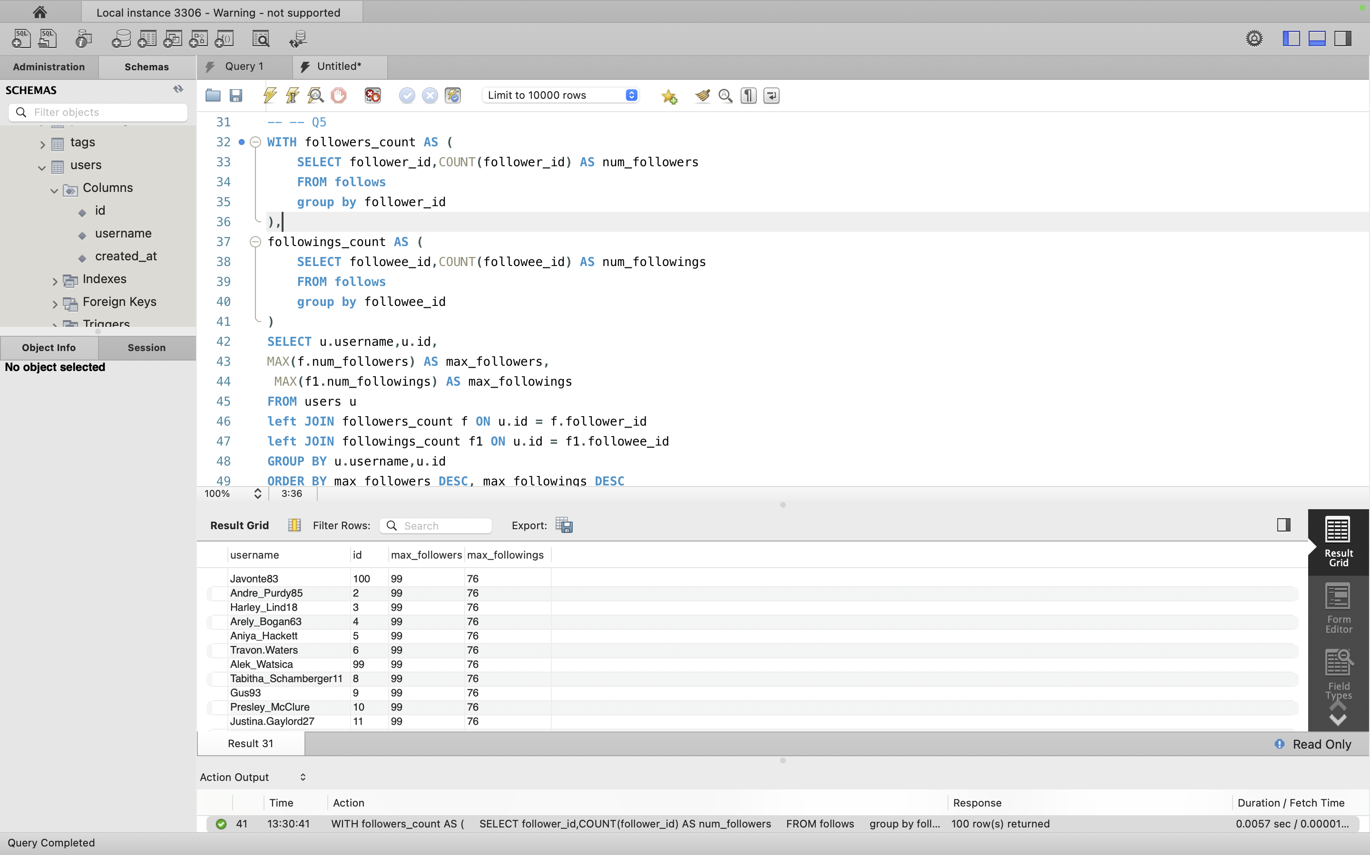
Highest number of followers and followings of users..

Slide 12
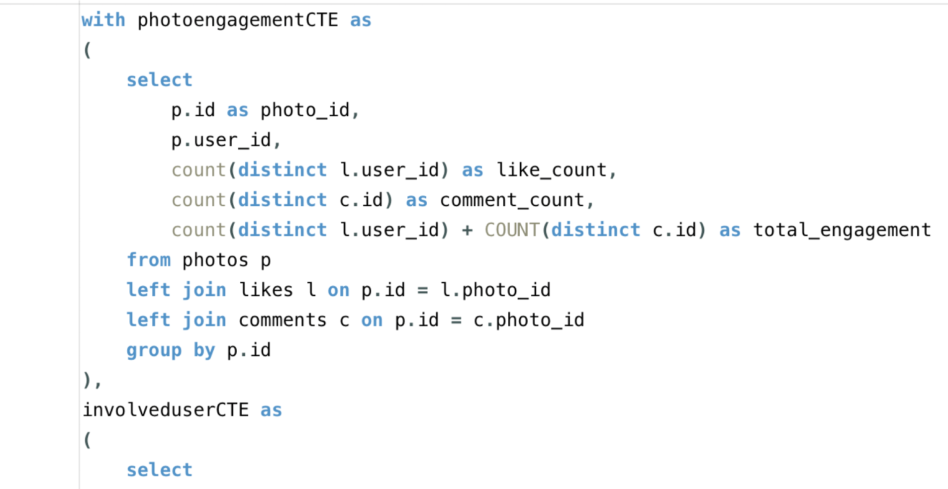
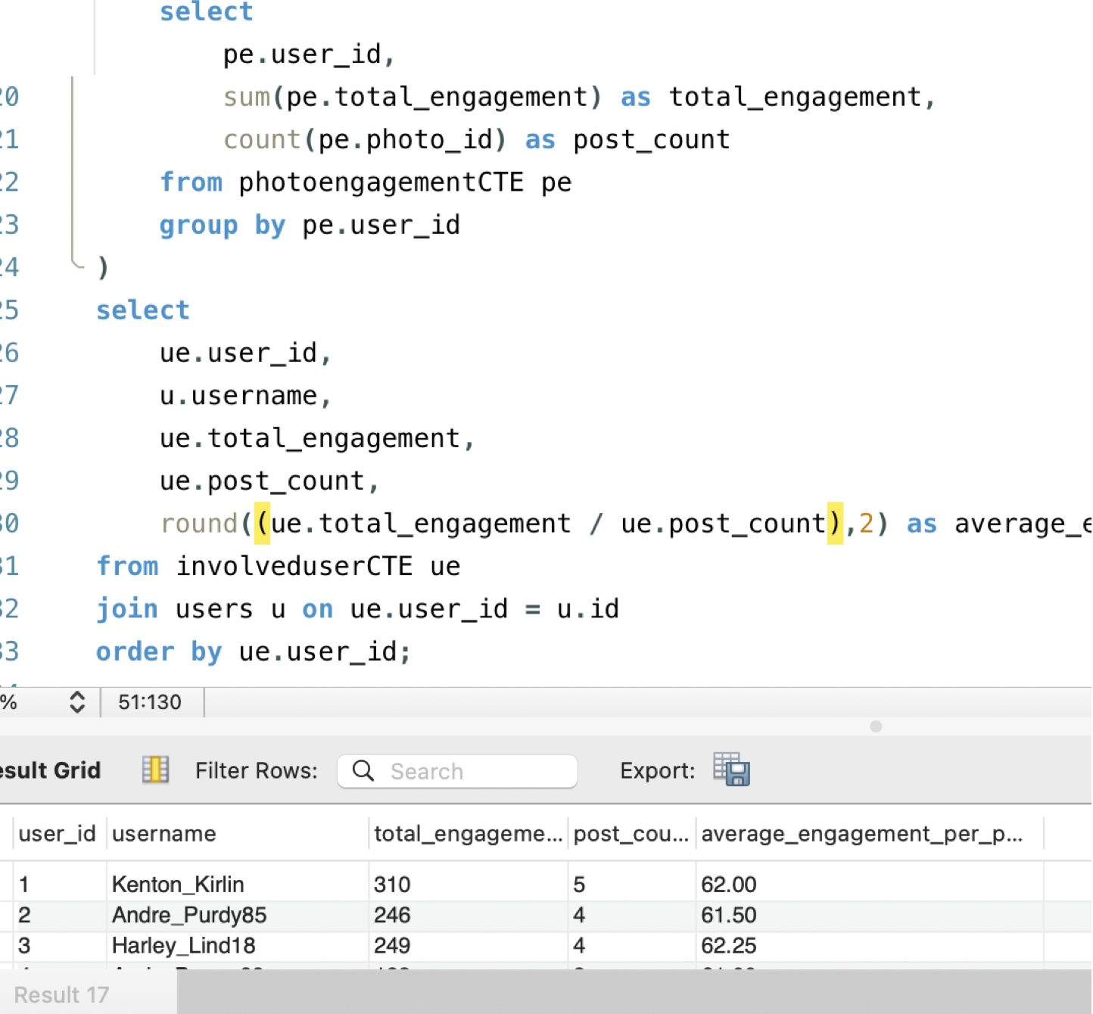
Average engagement rate (likes, comments) per post for each user.

Slide 13
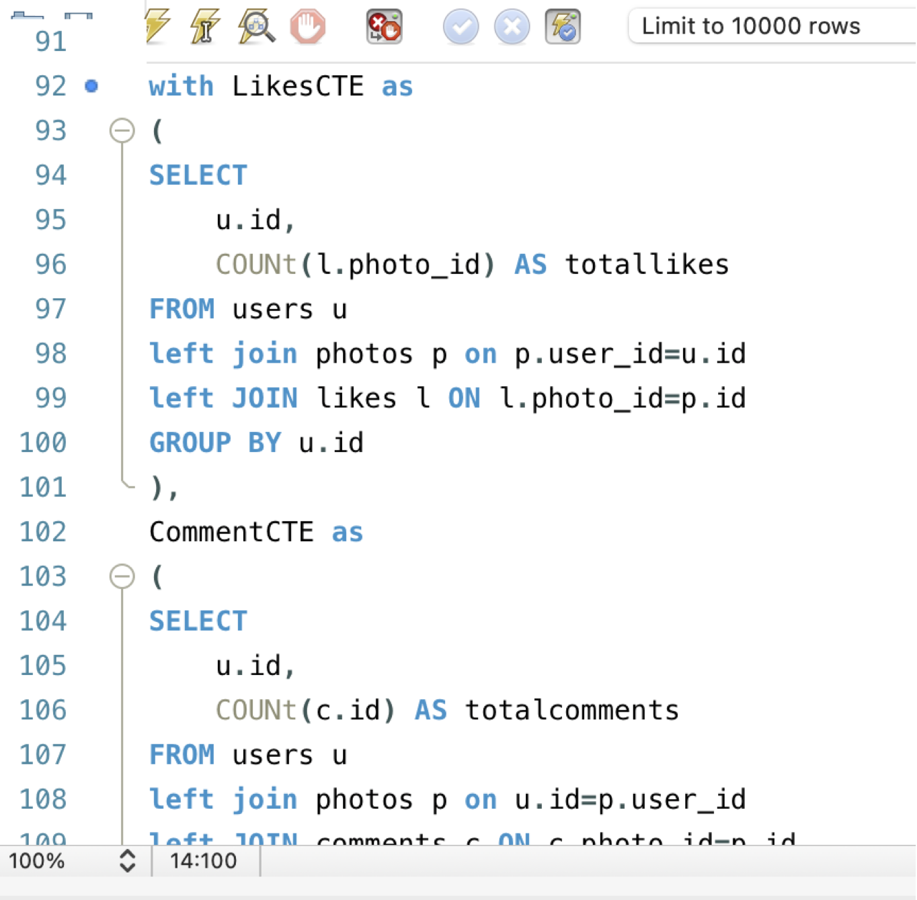
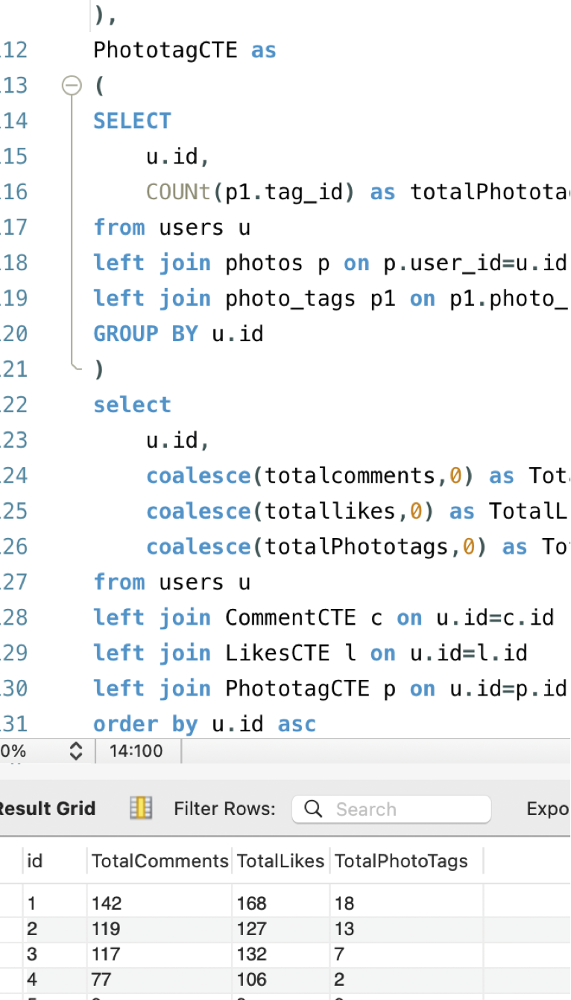
The total number of likes, comments, and photo tags for each user.

Slide 14
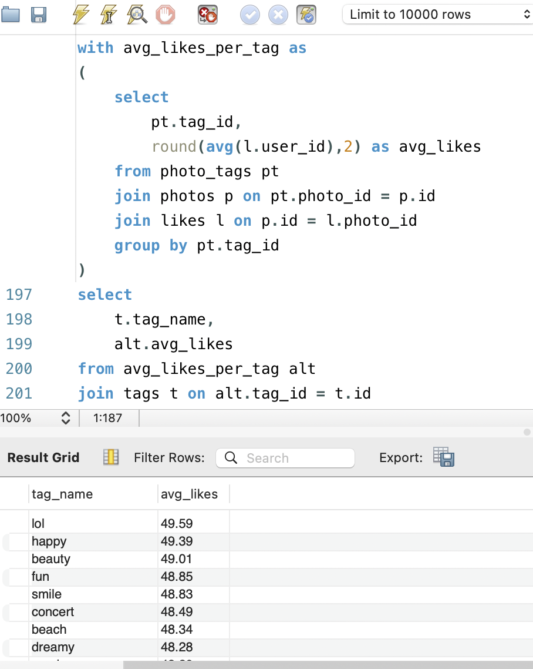
The average likes for each hashtag first.

Slide 15
conclusion
result
Learnt fundamentals of data analysis using SQL queries to extract insights from database by which we track how users engage and interact with our digital product (software or mobile application) in an attempt to derive business insights for marketing, product & development teams.
Marketing team can reward the most loyal customers, send promotional emails to inactive users, use popular hashtags and most active day for brand promotions. ➢ User engagement can be very useful growth success metric for the company ➢ Company can remove the bots and fake accounts from the platform to enhance the user experience

Slide 16
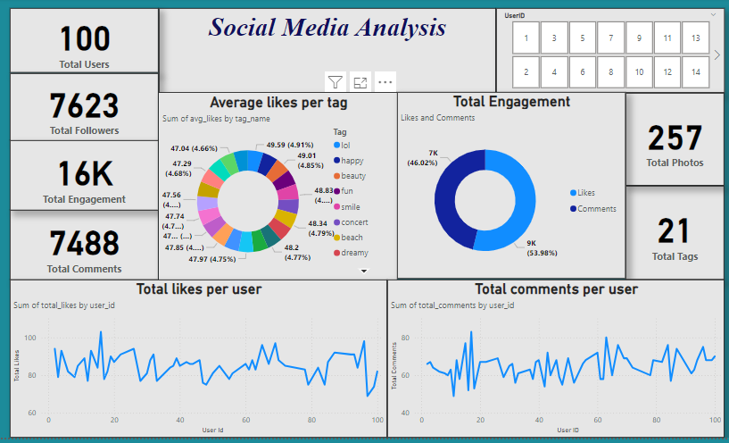

Slide 17
THANK YOU

